Slide 1

Duck Agents
Team Duck Agent: 42xNeedle Hackathon 2026

Slide 2









Meet the Duck Agent Flock
🦆
Scout
🦆
Parser
🦆
Miner
🦆
Planner
🦆
Minimalist
🦆
Architect
🦆
Builder
🦆
Tactician
🦆
Tester
🦆
Debugger
🦆
Repairer
🦆
Critic
🦆
Validator
🦆
Logger
🦆
Coordinator
🦆
Guardrail

Slide 3
























Collaboration Protocol
Phase 1 — Understand
Phase 2 — Build
Phase 3 — Verify
Phase 4 — Govern

Slide 4

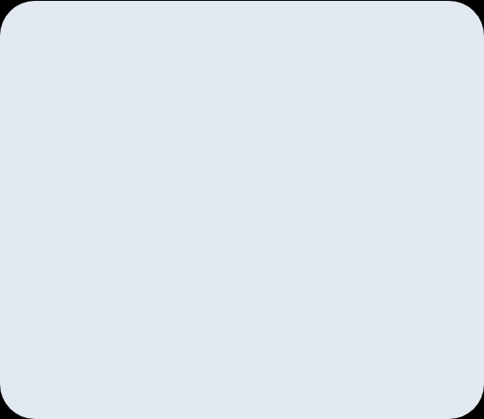
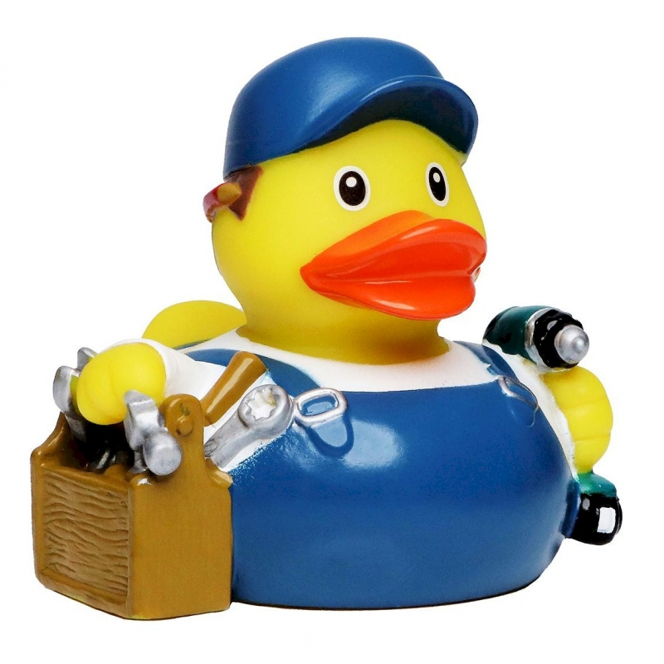
Decoding the Orchestrator Log
The Mastermind
Phase Switching: The Orchestrator acts as the brain, seamlessly transitioning between stages like Understand and Verify.
Role Assignment: Instead of a single AI trying to do everything, it summons specialized duck agents for targeted tasks.
The Goal: Write a perfect C itoa function entirely autonomously!

Slide 5






Phase 1: Understand
Scout & Parser
Miner
Coordinator
These agents scan the environment and parse the prompt to understand the ultimate goal: creating an itoa function in C.
Digs deep into the parsed data to extract the core constraints and logic: handling specific bases, pointers, and negative numbers.
Manages the flock, ensuring all prerequisites and rules are met before handing off the blueprint to the execution phase.

Slide 6

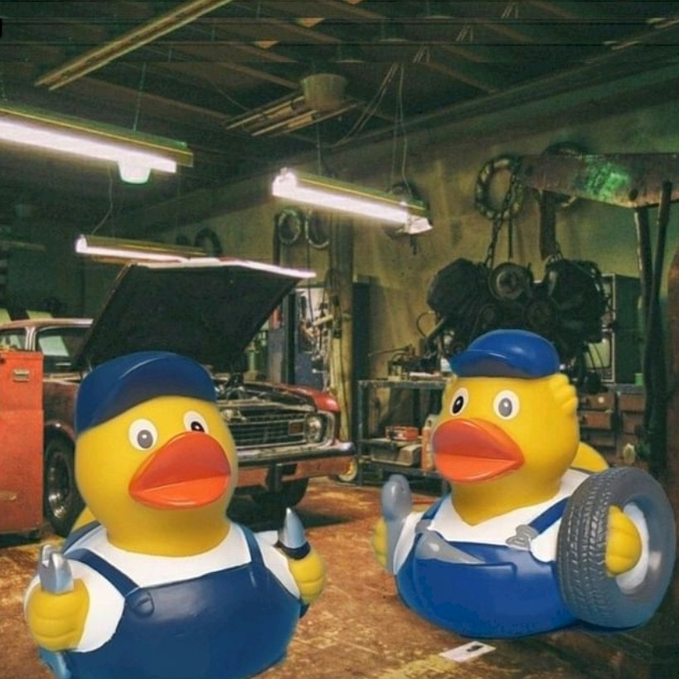
Phase 2: Execution & Code Generation
Writing Code
Once the 'Understand' phase finishes, agents trigger the WRITE_FILE action to generate itoa.c.
“But wait! The very first draft lacks a main() function, making it impossible to compile and test.”
The Orchestrator immediately notices the gap in logic and shifts gears.

Slide 7




Phase 3: Verify & Heal
Tester
Debugger
Repairer
Takes the generated itoa.c, adds a main() function, and compiles it using the RUN_TESTS action to see if it executes.
Catches the errors! It analyzes the test output and discovers undefined behavior because a crucial return statement was missing.
Rewrites the file iteratively based on the debug logs. It's an autonomous, self-healing loop striving for perfection!

Slide 8
Questions?
Team Duck Agent

